Slide 1

Anomalous Speed Detection Approach in Autonomous Vehicles with Alert Tracking System
CP5611 – DISSERTATION II
FIRST REVIEW on 21-06-2023
Supervised by,
Dr. R. Gunasekaran Professor Department of Computer Technology
Anna University, MIT Campus
Presented by,
R. Sreenithi (Reg.no:2021614028) M.E. CSE Final Year Department of Computer Technology
Anna University, MIT Campus

Slide 2
Overview
Introduction
Literature survey
Existing challenges
Problem statement
Objectives
Proposed System Architecture
Algorithms
References

Slide 3
Introduction
Autonomous Vehicles (AV) , known as self-driving cars or driverless cars, uses Artificial Intelligence (AI), sensors, and communication systems for autonomous operation.
AV optimize traffic flow, reduce fuel consumption and lessen risk of accidents.
Autonomous Vehicles can be categorized into five levels of automation.
Level 0: No automation
Level 1: Driver assistance – Adaptive Cruise Control (ACC), emergency braking and acceleration.
Level 2: Partial automation - Controls steering, acceleration, and braking.
Level 3: Conditional automation – operates independently in some driving situations.
Level 4: High automation - Operate independently in most driving situations, but require a human driver in certain circumstances.
Level 5: Full automation - Operate independently in all driving situations without human intervention.

Slide 4
Introduction (Cont.)
The below listed are the components of autonomous vehicles.
Sensors: cameras, radar, lidar, and ultrasonic sensors provide the vehicle a detailed view of its surroundings.
Control systems: Makes decisions about how to navigate their environment.
Communication systems: to exchange information with other vehicles such as traffic lights and road signs.
Mapping technology: Allows the road network, including lane markings, road signs, and speed limits.
Actuators: variety of actuators, including motors and brakes, which allow the vehicle to accelerate, decelerate, and steer.

Slide 5
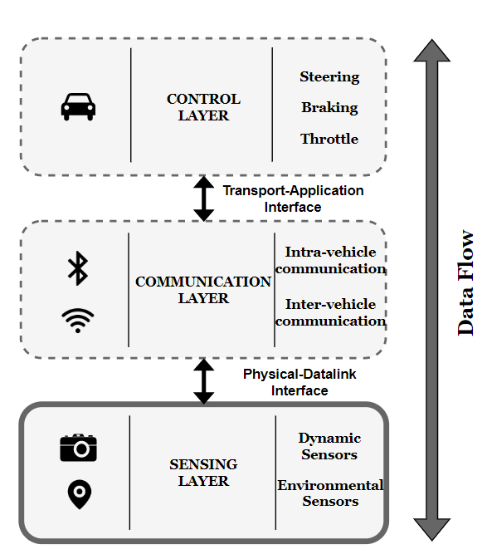
Autonomous Vehicle Architecture

Slide 6
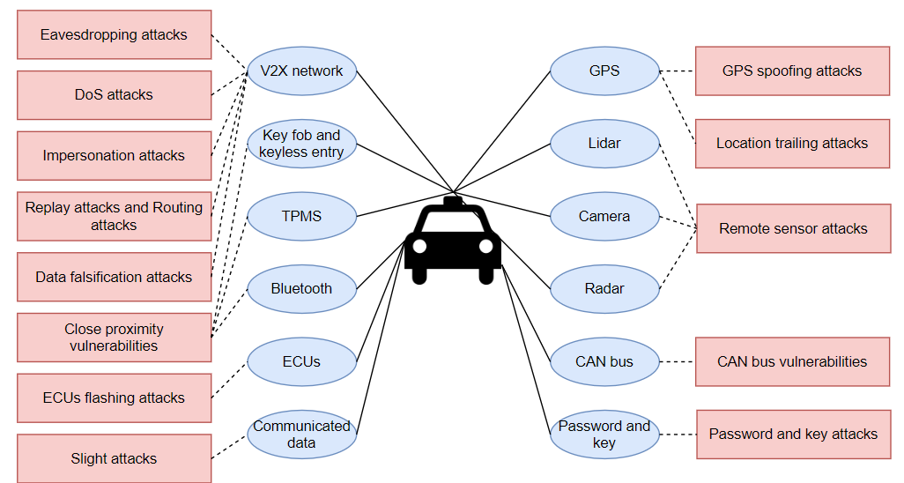
Attacks On AV Components

Slide 7
Literature Survey
SNO | TITLE OF THE PAPER | NAME OF THE JOURNAL AND PUBLISHED YEAR | PROPOSED WORK | PROPOSED METHODOLOGY /ALGORITHM | LIMITATIONS
1 | Anomaly Detection for Cooperative Adaptive Cruise Control in Autonomous Vehicles Using Statistical Learning and Kinematic Model | IEEE Transactions on Intelligent Transportation Systems, Vol. 22, No. 6, JUNE 2022 | Cooperative Adaptive Cruise Control (CACC) in platoon autonomous vehicles. Kinematic model is also utilized to detect unexpected deviations using the leader’s information, communicated directly and observed by the leader’s neighboring vehicle(s). | Generalized Extreme Studentized Deviate with Sliding Chunks (GESD-SC) approach applied at each vehicle in the platoon to detect anomalies based on the vehicle’s own speeding decisions. | Different speed attack scenarios and mobility models are not discussed.
2 | A Fault Detection and Diagnosis System for Autonomous Vehicles Based on Hybrid Approaches | IEEE Sensors Journal, Vol. 20, No. 16, AUG 15, 2020 | An accurate fault detection and diagnosis system to prevent the potential hazardous situations | Support Vector Machine (SVM) method is adopted to train the boundary curve which separates the safe domain and unsafe domain, a Kalman filter observer is designed to predict the current position of the vehicle | Type of the subsystem causes the fault

Slide 8
Literature Survey (Cont.)
SNO | TITLE OF THE PAPER | NAME OF THE JOURNAL AND PUBLISHED YEAR | PROPOSED WORK | PROPOSED METHODOLOGY /ALGORITHM | LIMITATIONS
3 | A Fast Anomaly Diagnosis Approach Based on Modified CNN and Multisensor Data Fusion | IEEE Transactions On Industrial Electronics, VOL. 69, NO. 12, DEC 2022 | A modified convolutional neural network (CNN) algorithm, namely 1D-GAPCNN-SVM, is proposed to address the early anomaly diagnosis problem. | To reduce the number of parameters, a 1-D global average pooling layer is designed, a nonlinear multiclass support vector machine (SVM) is adopted to replace the traditional Softmax classifier as the final discriminator | 2D-model with inefficient multisensor data fusion
4 | CANnolo: An Anomaly Detection System Based on LSTM Autoencoders for Controller Area Network | IEEE Transactions On Network And Service Management, VOL. 18, NO. 2, JUN 2021 | CANnolo, an IDS based on Long Short-Term Memory (LSTM)- autoencoders to identify anomalies in Controller Area Networks (CANs) | CANnolo automatically analyzes the CAN streams and builds a data sequences and detects anomalies by computing difference between the reconstructed and the respective real sequences. | Different data over time series makes it relatively slow computation

Slide 9
Literature Survey (Cont.)
SNO | TITLE OF THE PAPER | NAME OF THE JOURNAL AND PUBLISHED YEAR | PROPOSED WORK | PROPOSED METHODOLOGY /ALGORITHM | LIMITATIONS
5 | A Unified Bayesian Framework for Joint Estimation and Anomaly Detection in Environmental Sensor Networks | IEEE ACCESS ,DEC 2022 | A novel unified Bayesian framework that enable simultaneous estimation and identification of multiple and possibly different types of anomalies that can affect sensors in environmental sensor networks | The optimal joint maximum-likelihood and maximum a-posteriori (ML-MAP) estimation method to achieve almost the same performance of the joint ML-MAP | Computational complexity in cost analysis, to increase the percent of faulty nodes in network
6 | A Fault Detection and Diagnosis System for Autonomous Vehicles Based on Hybrid Approaches | IEEE Sensors Journal, VOL. 20, NO. 16, AUG 15, 2020 | An accurate fault detection and diagnosis system to prevent the potential hazardous situations | Support Vector Machine (SVM) method is adopted to train the boundary curve which separates the safe domain and unsafe domain, a Kalman filter observer to predict the current position of the vehicle | Type of the subsystem causes the fault

Slide 10
Literature Survey (Cont.)
SNO | TITLE OF THE PAPER | NAME OF THE JOURNAL AND PUBLISHED YEAR | PROPOSED WORK | PROPOSED METHODOLOGY /ALGORITHM | LIMITATIONS
7 | Filter-Based Secure Dynamic Pose Estimation for Autonomous Vehicles | IEEE Sensors Journal, VOL. 19, NO. 15, AUG 1, 2019 | Recursive secure dynamic estimator has been designed to tackle the state estimation problem for autonomous vehicles in the circumstance of possible sensor attacks | Proposed estimator coincides with the conventional Kalman filter when all sensors on autonomous vehicles are benign | Pose estimation when sensors fail
8 | Learning-Based Attacks in Cyber-Physical Systems | IEEE Transactions On Control Of Network Systems, VOL. 8, NO. 1, MAR 2021 | An arbitrary learning algorithm to estimate the system dynamic | The controller improves the security imposing crafted privacy-enhancing signal on top of the “nominal control policy.” | Controller does not know the exact time instant at which an attack might occur as in non-linear system

Slide 11
Literature Survey (Cont.)
SNO | TITLE OF THE PAPER | NAME OF THE JOURNAL AND PUBLISHED YEAR | PROPOSED WORK | PROPOSED METHODOLOGY /ALGORITHM | LIMITATIONS
9 | “Seeing is Not Always Believing”: Detecting Perception Error Attacks Against Autonomous Vehicles | IEEE Transactions On Dependable And Secure Computing, VOL. 18, NO. 5, OCT 2021 | The impact of perception error attacks (PEAs) on autonomous vehicles, and propose a countermeasure called LIFE | The impact of perception error attacks (PEAs) and propose a countermeasure called LIFE (LIDAR and Image data Fusion for detecting perception Errors) | Lack of data, with good weather and excellent field of view to driver
10 | Toward Interpretability in Fault Diagnosis for Autonomous Vehicles: Interpretation of Sensor Data Anomalies | IEEE Sensors Journal, VOL. 23, NO. 5, 1 MARCH 2023 | Environmental impact is first evaluated using the noise energy as a measure to interpret the impact on sensor data caused by the environment | Savitzky–Golay filters are applied for online denoising, to mitigate the impact and to enhance the data quality. Adversarial learned denoising shrinkage autoencoder (ALDSAE), an adversarial learning neural network, is constructed for sensor data anomaly detection | Fault interpretation in Avs are complex to compute

Slide 12
Existing Challenges
It is a challenge to distinguish between intentional and unintentional interference in spoofing attacks.
Pose estimation is a critical problem in autonomous vehicle navigation, especially in circumstances where sensor failure or attacks exist.
An accurate fault detection and diagnosis system is of great importance for autonomous vehicles to prevent the potential hazardous situations.
Modern vehicles are vulnerable to multiple types of attacks leveraging remote, direct and indirect physical access, which allow attackers to gain control and affect safety-critical systems.

Slide 13
Problem Statement
Autonomous vehicles rely on various sensors, software components to navigate and make decisions.
Spoofing attack in vehicles can manipulate the speed data derived from magnetic encoders and inertial sensors providing falsified data to other vehicles leading to chaos.
The safe distance between the vehicle helps to detect the spoofing attack in wheel sensors to analyze presence of anomalies.
This manipulation can mislead the AVs into making incorrect decisions based on the spoofed sensor information.
The proposing Autonomous Vehicle Safe Distance (AVSD) algorithm helps to identify the safe and un-safe distance between the vehicles as the primary detection of spoofing attack.

Slide 14
Objectives
To identify the spoofing attack in dynamic sensor of autonomous vehicles and the correlation between the velocity and acceleration impact the overall performance of the autonomous system.
To identify the safe distance between the preceding and succeeding vehicle for primary detection of spoofing attack in vehicles using Autonomous Vehicle Safe Distance algorithm (AVSD).
To identify the abnormal speed of the vehicles by monitoring their velocity and acceleration and producing alerts to other vehicles.

Slide 15
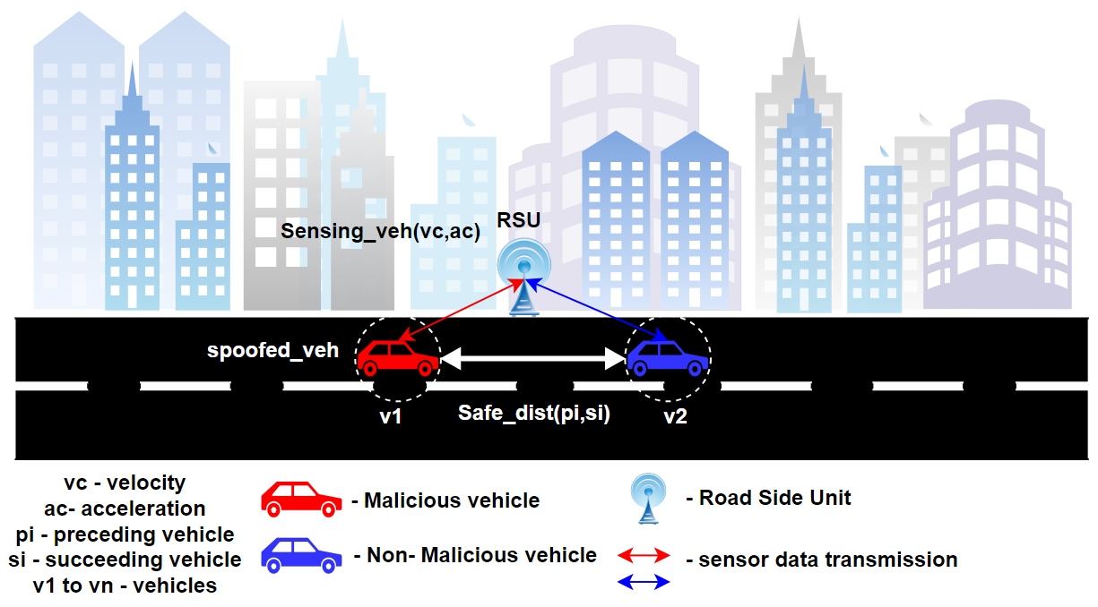
Proposed System Scenario

Slide 16
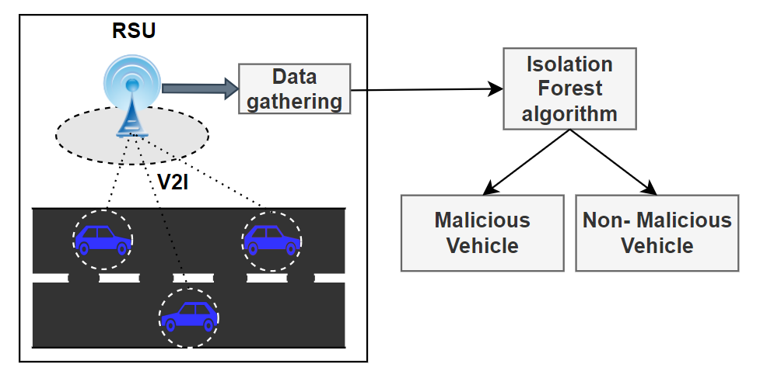
Proposed System Architecture

Slide 17
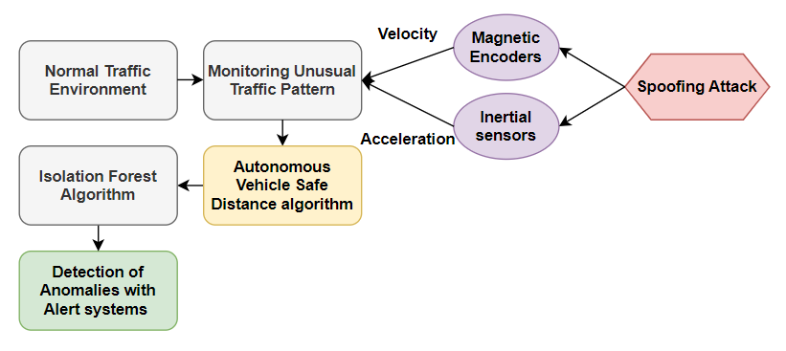
Proposed System Flow

Slide 18
Algorithms Algorithm 1 - AVSD - Autonomous Vehicle Safe Distance Algorithm
Algorithm: AVSD (Autonomous Vehicle Safe Distance Algorithm)
Input:
v <- vehicles (veh1, veh2, ..., vehn)
L <- Lanes (L1, L2, ..., Ln)
Output:
vehicle id of safe vehicle and unsafe vehicle via lanes
1. Initialize vehicle count for each lane:
veh_count <- {0} for each lane L
2. For each veh in v:
a. Compute the distance between the preceding vehicle and the succeeding vehicle for a minimum gap
pv_dist <- compute_preceding_veh_dist(v)
sv_dist <- compute_succeeding_veh_dist(v)

Slide 19
Algorithm (Cont..)
Function compute_preceding_veh_dist(v):
pv_dist = infinity
for each preceding_veh in v on the same lane as vehicle:
if preceding_veh.position < veh.position:
dist = veh.position - preceding_veh.position - preceding_veh.length
pv_dist = min(pv_dist, dist)
return pv_dist
Function compute_succeeding_veh_dist(v):
sv_dist = infinity
for each succeeding_veh in v on the same lane as vehicle:
if succeeding_veh.position > veh.position:
dist = succeeding_veh.position - veh.position - veh.length
sv_dist = min(sv_dist, dist)
return sv_dist

Slide 20
Algorithm (Cont..)
b. Calculate the minimum gap:
min_gap <- min(pv_dist, sv_dist)
c. Check if the minimum gap is greater than or equal to 5.00 meters:
if min_gap >= 5.00:
Set vehicle v as safe
else:
Increment the vehicle count for the lane of vehicle v:
veh_count[L[v]] <- veh_count[L[v]] + 1
3. Return the vehicle count via lanes: veh_count

Slide 21
References
W. Gong, Y. Wang, M. Zhang, E. Mihankhah, H. Chen and D. Wang, "A Fast Anomaly Diagnosis Approach Based on Modified CNN and Multisensor Data Fusion," in IEEE Transactions on Industrial Electronics, vol. 69, no. 12, pp. 13636-13646, Dec. 2022.
Y. Fang, H. Min, W. Wang, Z. Xu and X. Zhao, "A Fault Detection and Diagnosis System for Autonomous Vehicles Based on Hybrid Approaches," in IEEE Sensors Journal, vol. 20, no. 16, pp. 9359-9371, 15 Aug.15, 2020.
S. Dasgupta, M. Rahman, M. Islam and M. Chowdhury, "A Sensor Fusion-Based GNSS Spoofing Attack Detection Framework for Autonomous Vehicles," in IEEE Transactions on Intelligent Transportation Systems, vol. 23, no. 12, pp. 23559-23572, Dec. 2022, doi: 10.1109/TITS.2022.3197817.
A. Fascista, A. Coluccia and C. Ravazzi, "A Unified Bayesian Framework for Joint Estimation and Anomaly Detection in Environmental Sensor Networks," in IEEE Access, vol. 11, pp. 227-248, 2023.
S. Longari, D. H. Nova Valcarcel, M. Zago, M. Carminati and S. Zanero, "CANnolo: An Anomaly Detection System Based on LSTM Autoencoders for Controller Area Network," in IEEE Transactions on Network and Service Management, vol. 18, no. 2, pp. 1913-1924, June 2021.

Slide 22
References (Cont.)
F. Guo et al., "Detecting Vehicle Anomaly in the Edge via Sensor Consistency and Frequency Characteristic," in IEEE Transactions on Vehicular Technology, vol. 68, no. 6, pp. 5618-5628, June 2019.
X. Liu, R. Jiang, H. Wang and S. S. Ge, "Filter-Based Secure Dynamic Pose Estimation for Autonomous Vehicles," in IEEE Sensors Journal, vol. 19, no. 15, pp. 6298-6308, 1 Aug.1, 2019.
M. J. Khojasteh, A. Khina, M. Franceschetti and T. Javidi, "Learning-Based Attacks in Cyber-Physical Systems," in IEEE Transactions on Control of Network Systems, vol. 8, no. 1, pp. 437-449, March 2021.
J. Liu and J. -M. Park, "“Seeing is Not Always Believing”: Detecting Perception Error Attacks Against Autonomous Vehicles," in IEEE Transactions on Dependable and Secure Computing, vol. 18, no. 5, pp. 2209-2223, 1 Sept.-Oct. 2021.
J. Liu and J. -M. Park, "“Seeing is Not Always Believing”: Detecting Perception Error Attacks Against Autonomous Vehicles," in IEEE Transactions on Dependable and Secure Computing, vol. 18, no. 5, pp. 2209-2223, 1 Sept.-Oct. 2021.
Z. El-Rewini, K. Sadatsharan, N. Sugunaraj, D. F. Selvaraj, S. J. Plathottam and P. Ranganathan, "Cybersecurity Attacks in Vehicular Sensors," in IEEE Sensors Journal, vol. 20, no. 22, pp. 13752-13767, 15 Nov.15, 2020, doi: 10.1109/JSEN.2020.3004275.

Slide 23
Thank you

